Slide 1
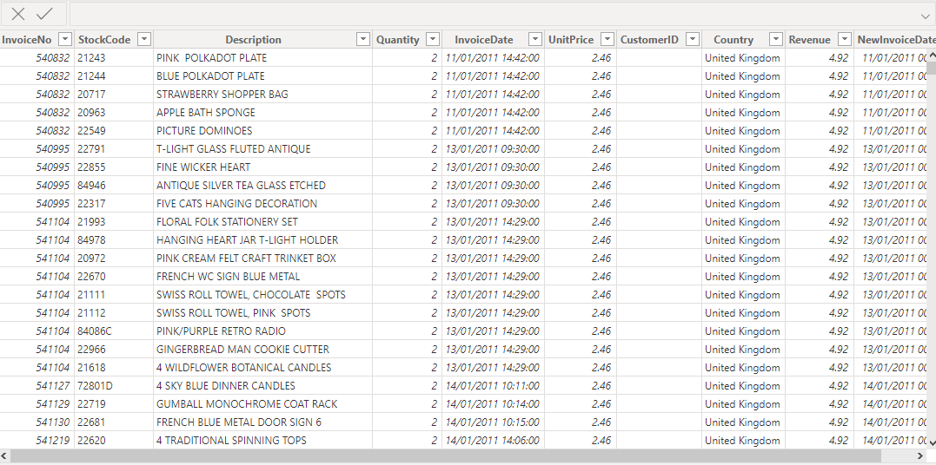
DATA COLLECTION AND PREPARATION

Slide 2
Data cleaning and preparation steps
Imported data from excel
Transformed data on transforming option
Changed data type on the StockCode column to text
Created a check that ensures quantity is not below 1 unit and the Unit price is not below $0
Created a new column called Newinvoicedate using the DATEVALUE function
Created a measure for revenue where quantity is multiplied by price

Slide 3
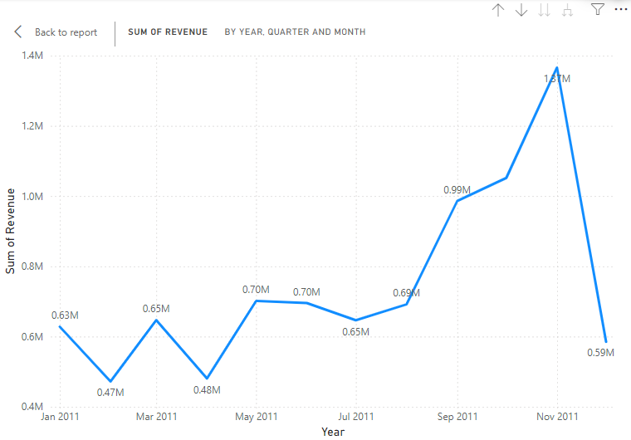
Q1 TIME SERIES OF REVENUE DATA FOR 2011

Slide 4
INSIGHTS
Visualization is revenue by month and year
I used a line chart
The year is set to 2011
The retail store recorded the highest revenue in November at 1.37 M.
While the lowest sale revenue was on Febuary at 0.47 M.

Slide 5
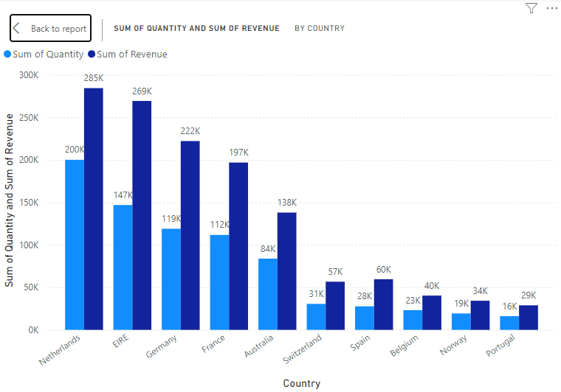
TOP 10 REVENUE GENERATING COUNTRIES EXCEPT UK

Slide 6
INSIGHTS
The visualization was to get the revenue and Sum of Quantity by country
I used a clustered column chart because of having two fields
I also excluded UK from the visual.
Netherlands has the highest revenue at 285k with the highest quantity at 200k while Portugal generated the least at 29k with quantity at 16k.

Slide 7
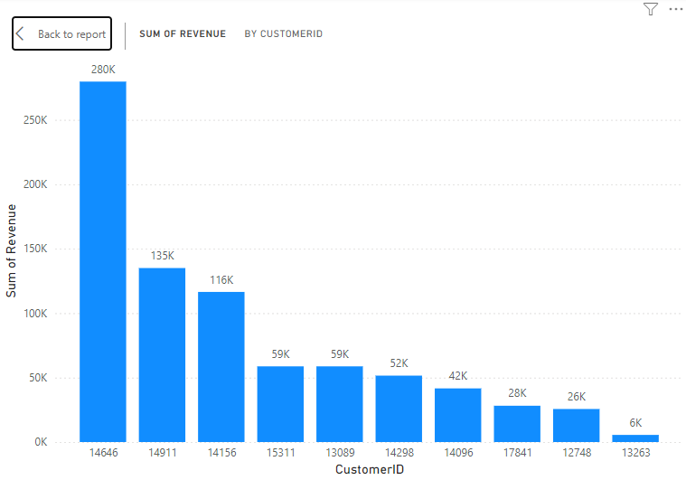
TOP 10 CUSTOMERS BY REVENUE

Slide 8
INSIGHTS
Customer 14646 has the highest revenue of 280k and customer 13263 has the lowest reveue of 6k

Slide 9
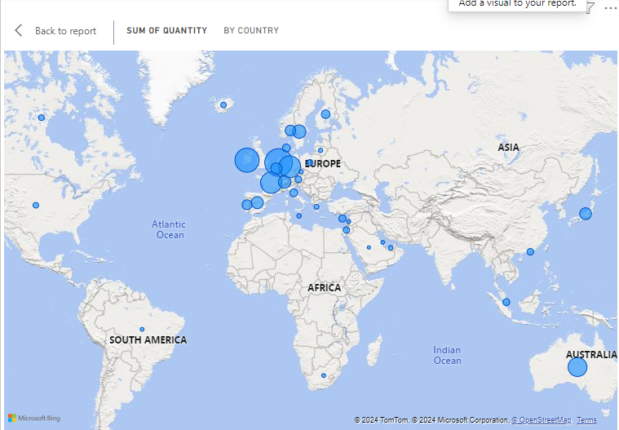
Demand for products by country

Slide 10
INSIGHTS
Europe generates higher revenue with Netherlands having a revenue of 285k

